Slide 1
Preliminary Design of a Cube Satellite Compliant Hall Thruster
Alexis M. F. Hepburn, Embry-Riddle Aeronautical University
April 18, 2020

Slide 2
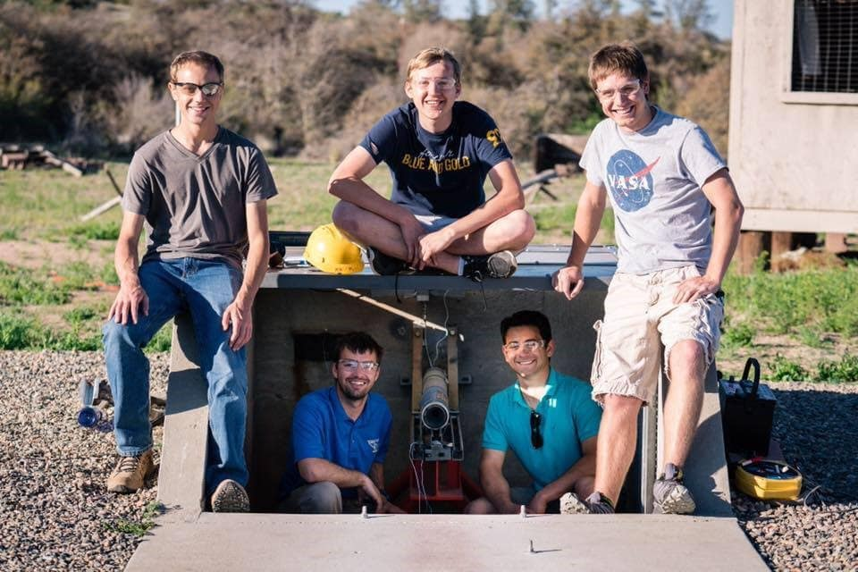
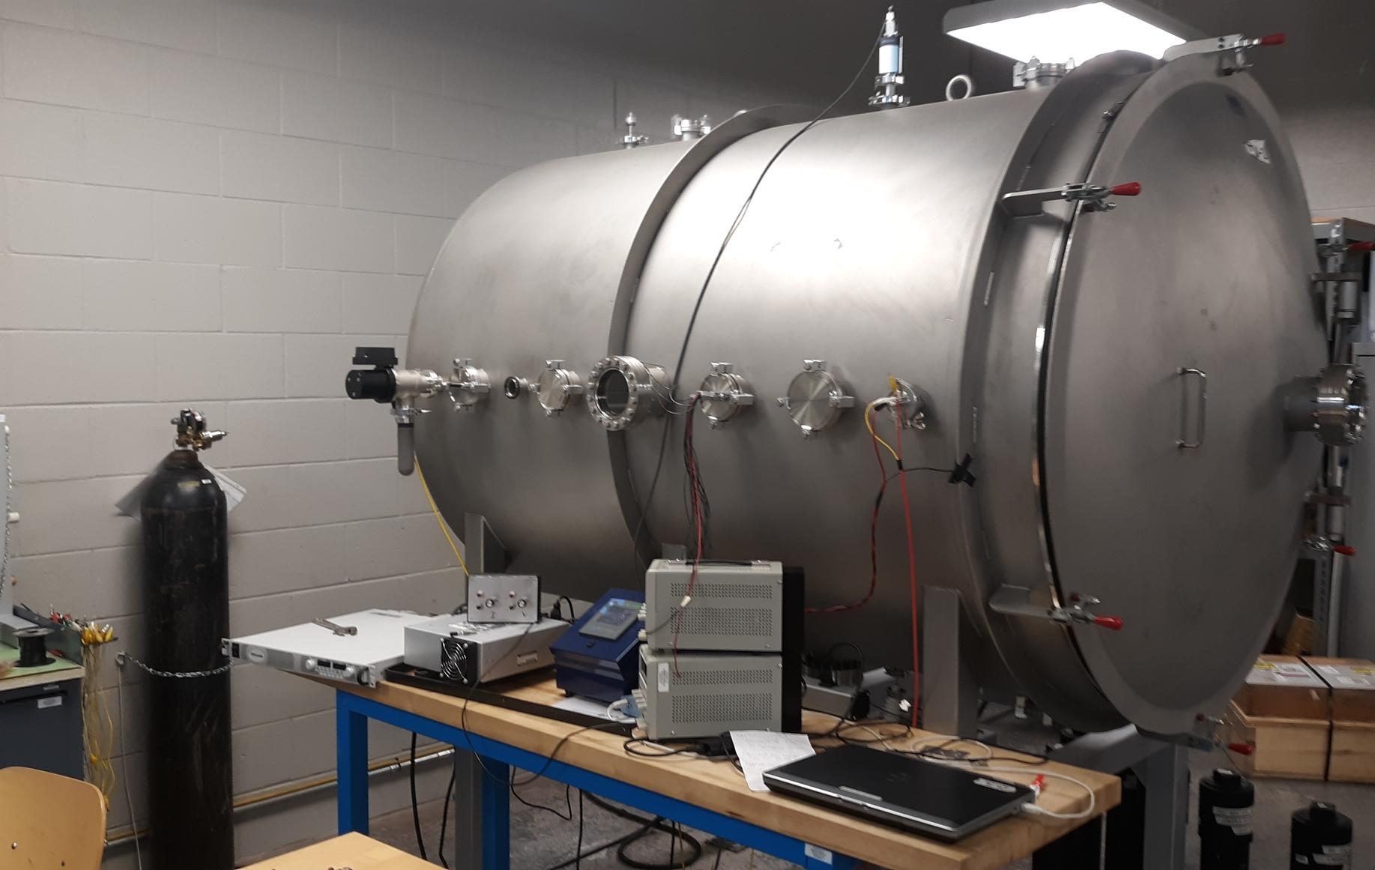
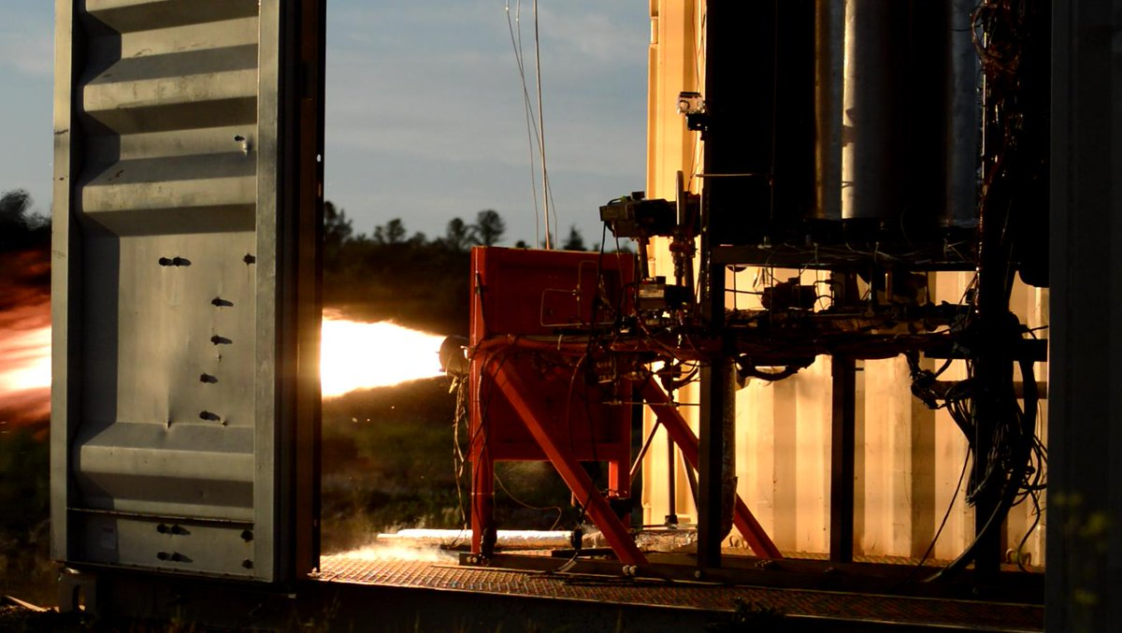
ERAU Propulsion Efforts
Liquid Rocket Engine Testing
Solid Rocket Motor Testing
Electric Thruster Testing

Slide 3
CubeSat History
History
Started by CalPoly and Stanford in 1999
Over 1,000 launched as of Jan. 2019
Applications
Earth observation
Amateur radio
Flight V&V for new hardware
Academic institution research

Slide 4
AGENDA
CubeSat Requirements
Size (per unit)
Volume: 1,000 cm³
Mass:1.3 kg
Propulsion
Non-volatile propellants
No pyrotechnics
No high-pressure working fluids
Parameter | Complication
Thruster Efficiency | Poor propellant utilization due to broad distribution of ion exit velocities
Thruster Lifetime | Historically higher channel erosion rates
Thermal Management | Heat transfer by radiation is poor, increasing steady state temperature

Slide 5
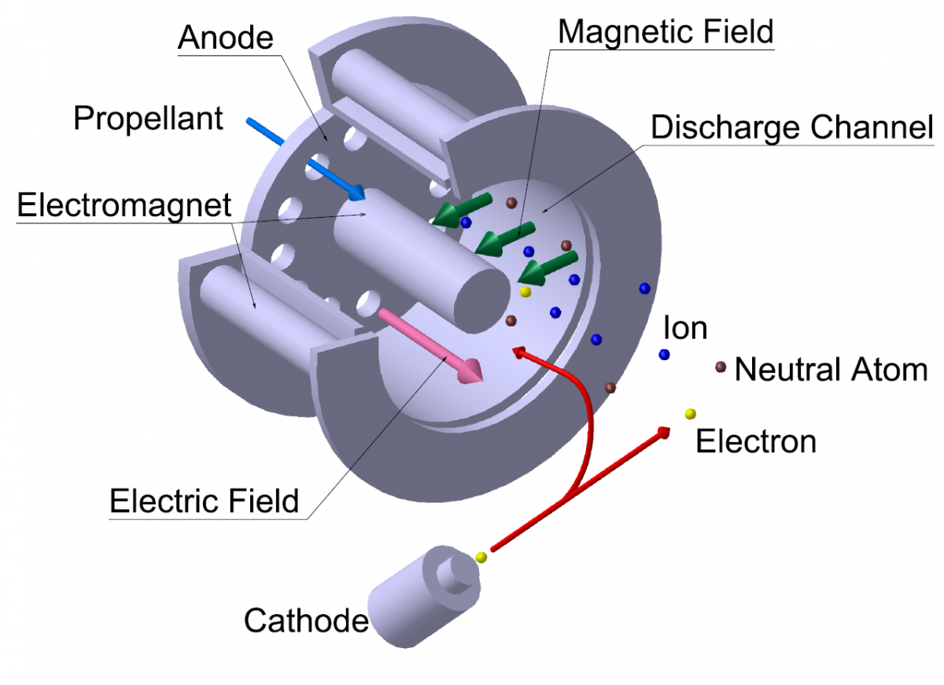
Hall Thrusters
Electrostatic System
Electric field accelerates
Magnetic field condenses
Common Propellants
Xenon
Argon
Figure 1: Hall Thruster [1]
Notes:
https://uzay.tubitak.gov.tr/en/uydu-uzay/hale

Slide 6
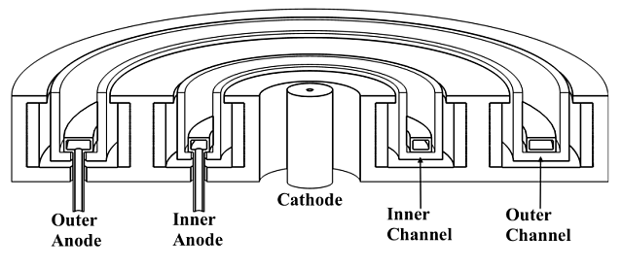
SPT-Type
Insulator
Conductor
Notes:
https://beyondnerva.com/electric-propulsion/hall-effect-thrusters/

Slide 7
Research Objectives
Develop a CubeSat compliant SPT HET
Based on Russian OKB Fakel SPT-100
Utilizing conventional electromagnetism physics
Mission
Parameter | Translation | Goal Value
Delta-V | Energy to move vehicle | 2 km/s
Firing Time | Engine operating time | 1,000 – 2,000 hrs
Propellant Throughput | Fuel consumed | 2 – 2.5 kg
Isp | Fuel efficiency | 1,250 s

Slide 8
Research Benefits
ERAU
First EP attempt
New safety procedures
Hardware for future projects
Representation in a new industry
Industry/Academia
Exploration of vaporized metals
Development of cube satellite compliant propulsion
Open source designs and artifacts
Element | Molecular Weight (AMU) | Cost (USD/kg) | Melting Point (°C) | Ionization Energy (kJ/mol) | Reactivity
Magnesium | 24 | 37 | 650 | 738 | Moderate
Zinc | 65 | 53 | 420 | 906 | Low
Bismuth | 209 | 39 | 271 | 703 | Low
Mercury | 201 | 48 | -39 | 1007 | Low
Lead | 207 | 23 | 327 | 716 | Low

Slide 9
AGENDA
Thruster Design
Materials
A36 Steel
Alumina Silicate
Stainless Steel
SEM Cathode
Manufacturability
Single plate thicknesses
Single screw size
Machined in house
Cost to Date
Engine: $815 (w/ redundancies)
Permanent hardware: $650
0.5 In.
3.3 In.
Figure 4: Current ERAU Hall Thruster Model

Slide 10
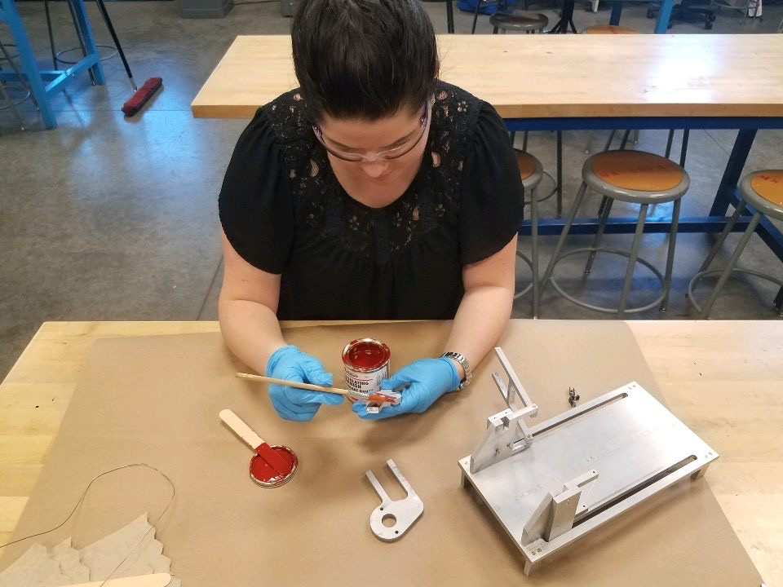
AGENDA
Test Article Preparation
Machining
All components were machined
deburred
Insulating
Every metallic component was insulated with electrical and thermal insulation varnish
Electrical Continuity Tests
Each electrical connection was verified after each step to ensure continuity

Slide 11
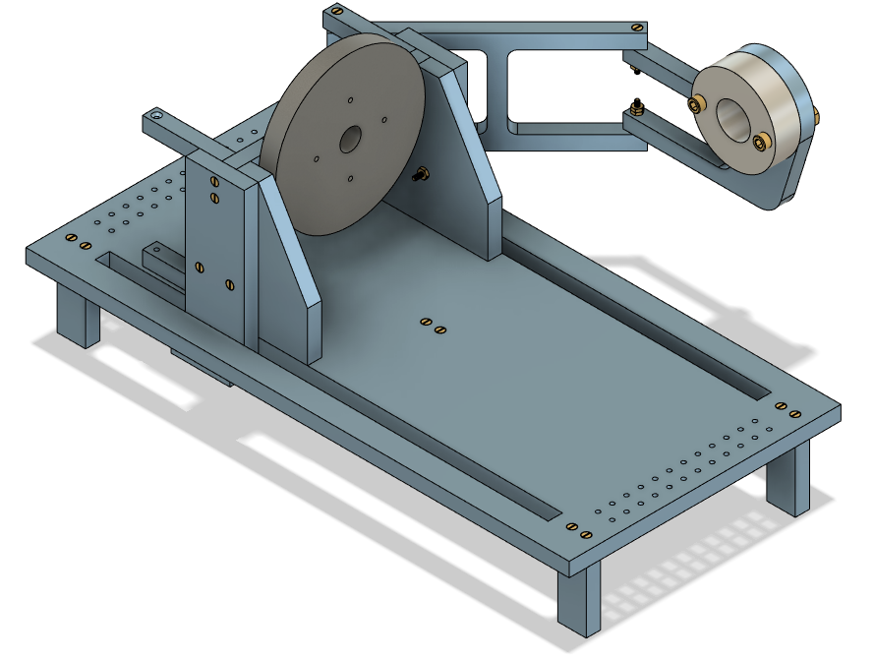
AGENDA
Test Stand
Cathode Mount
Variable distance and angle of intersection to plasma discharge
Thruster Integration Plate
Removeable thruster integration plate permits construction separate of the test stand
Grounded legs
Thruster remains an independent electrical circuit
Sliding Channels
Test article can be moved closer and farther from test instruments
Data Acquisition Attach Points
Modular holes for integration of test equipment

Slide 12
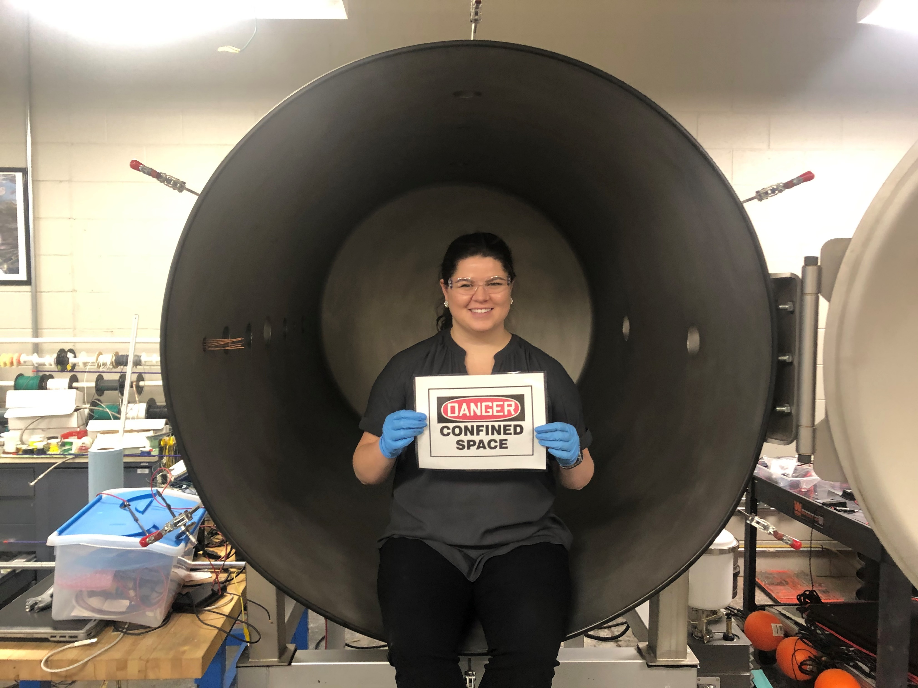
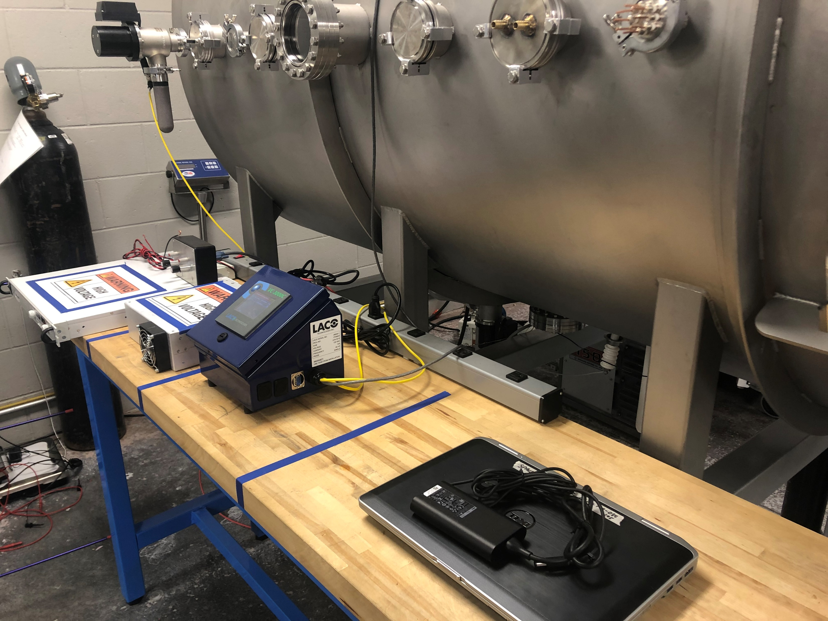
AGENDA
Vacuum Chamber Preparation
BEFORE
AFTER

Slide 13
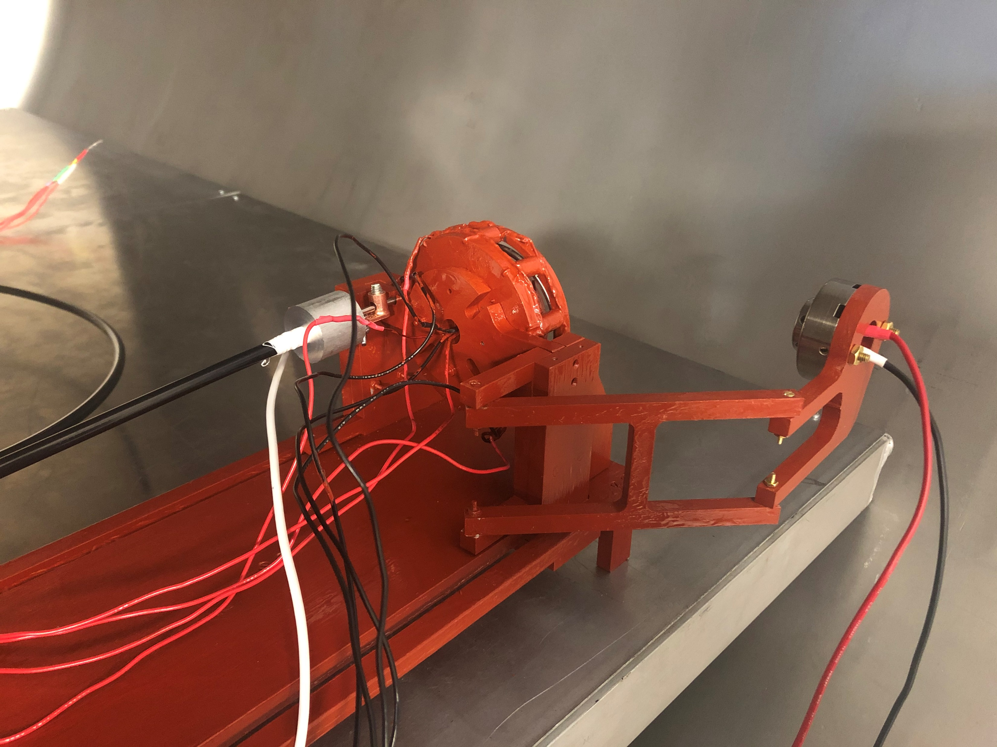
AGENDA
Testing Integration
Anode System
Thruster
1/8”stainless steel tubing to 1/4” tubing with Teflon tape and ground wire
Mounted to a modular integration plate that can be removed from the thrust stand
Solenoid Electrical Connections
Cathode Electrical Connections
Inner and outer solenoids wired separately in four complete series circuits
Independent power source limits risk of damaging connections or overheating LaB₆ crystal

Slide 14
AGENDA
Current Timeline

Slide 15
AGENDA
Thank You
Dr. Anne Boettcher
Dr. Daniel White
Dr. Elliot Bryner
Nicholas Dyrland
Corey Bullens
ERAU Hazy Library Research Librarians
ERAU Machining Staff & Assistants
ERAU College of Engineering

Slide 16
AGENDA
Questions?
Alexis M. F. Hepburn
Aerospace Engineering, Senior – Undergraduate
Embry-Riddle Aeronautical University – Prescott, AZ
NASA AZ Space Grant Undergraduate Research Consortium Intern
NCHC Portz Interdisciplinary Research Fellow
ERAU Undergraduate Research Institute Ignite Grant Recipient
Linkedin.com/Alexis-Hepburn
Hepbura1@my.erau.edu

Slide 17
AGENDA
Propellant Selection
 | Molecular Weight (AMU) | Cost ($/kg) | Melting Point (°C) | Ionization Energy (kJ/mol) | Reactivity | Toxicity
Magnesium | 24 | 37 | 650 | 738 | Moderate | Low
Zinc | 65 | 53 | 420 | 906 | Low | Low
Bismuth | 209 | 39 | 271 | 703 | Low | Low
Mercury | 201 | 48 | -39 | 1007 | Low | High
Lead | 207 | 23 | 327 | 716 | Low | High
Table 1: Metallic Propellant Trade Study [4,5]

Slide 18
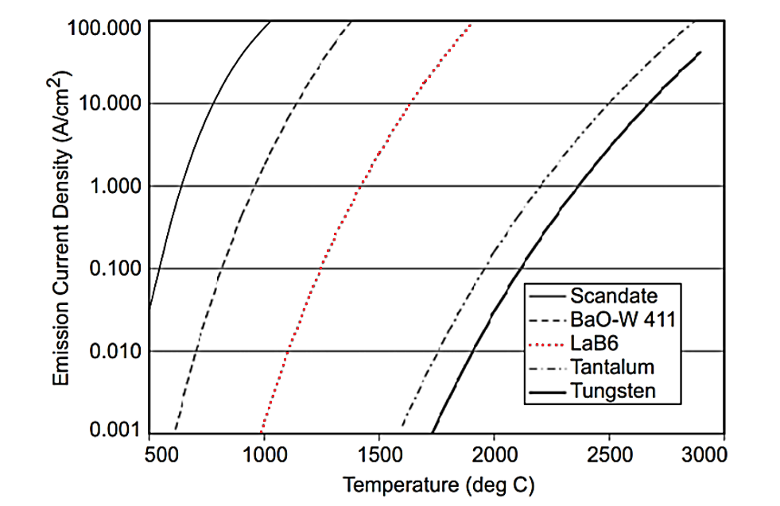
AGENDA
Cathode Selection
Figure 5: Evaporation Rate of Type-S 4:1:1 - dispenser cathodes, LaB6, and tungsten [6]
Figure 6: Emission current density versus temperature for various cathode materials [6]

Slide 19
AGENDA
Insulator Selection
Alumina Silicate
Easily machined in house
Cheap and readily available online
Important component in refractory ceramics and temperature insulators
High temperature strength
Low coefficient of thermal expansion
Dimensions
 | ID (in.) | OD (in.) | Height (in.)
Outer Channel | 2.75 | 2.85 | 0.50
Inner Channel | 2.36 | 2.46 | 0.50
Figure 7: Current ERAU Hall Thruster Model - Insulators

Slide 20
AGENDA
Magnetic Circuit Design
A36 Steel
Low carbon: Easily machined in house
Cheap and readily available online
High electrical conductivity
Bobbin Assembly
Hand wound high gauge wire around machined A36 cylinders
4-inner and 10-outer bobbins total
Figure 8: Current ERAU Hall Thruster Model - Bobbins

Slide 21
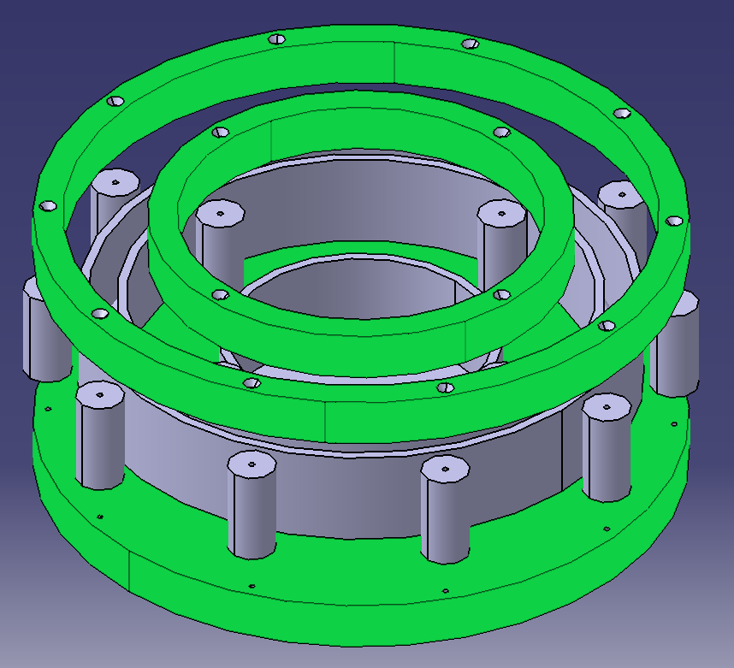
AGENDA
Magnetic Circuit Design
A36 Steel
Low carbon: Easily machined in house
Cheap and readily available online
High electrical conductivity
Face Assemblies
Water jet cut from a common thickness plate/bar
Direct interface with bobbins and electrical power systems
Figure 9: Current ERAU Hall Thruster Model - Irons

Slide 22
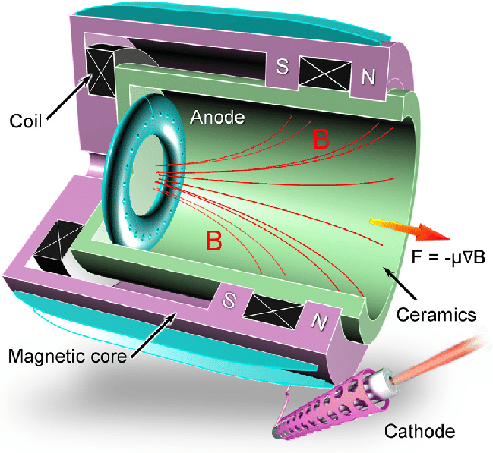
AGENDA
Anode Design
Stainless Steel
Easily machined in house
Cheap and readily available online
Corrosion resistant
Low coefficient of thermal expansion
Anode Manufacturing
Seal one end of 1/8 in. OD tube (ID: 0.028 in.)
Drill 10 evenly spaced 1/32 in. diameter holes
Bend thin walled tube around a 2.475 in. mandrel
Bend open end down and feed through hole in back iron plate
Figure 10: Hall Thruster Cut Away [7]
Notes:
https://www.researchgate.net/figure/Schematic-of-a-cylindrical-Hall-thruster-CHT-36-A-smaller-surfaceto-volume-ratio-in_fig8_323376145

Slide 23
Sources
“HALE,” HALE | SPACE TECHNOLOGIES RESEARCH INSTITUTEAvailable: https://uzay.tubitak.gov.tr/en/uydu-uzay/hale.
“Hall Effect Thrusters,” Beyond NERVAAvailable: https://beyondnerva.com/electric-propulsion/hall-effect-thrusters/.
“Beyond frontiers,” SESAvailable: https://www.ses.com/.
“Periodic Table – Royal Society of Chemistry,” Royal Society of Chemistry - Advancing excellence in the chemical sciencesAvailable: http://www.rsc.org/periodic-table/.
UCSB Science LineAvailable: http://scienceline.ucsb.edu/getkey.php?key=928.
Goebel, D. M., and Katz, I., Fundamentals of electric propulsion: ion and hall thrusters, Hoboken: John Wiley, 2008.
Levchenko, I., and , “Space micropropulsion systems for Cubesats and small satellites: From proximate targets to furthermost frontiers,” Applied Physics Review Available: .

